Slide 1
BetterReads
Kelsey, Ryan, Jarod

Slide 2
What to Expect
Why BetterReads?
The database we used.
ER time.
Relational models
Backend and frontend
All the queries
Evaluation
Lessons Learned
Conclusion

Slide 3
Why BetterReads?
Short answer, GoodReads is owned by Amazon now. Sounds like more monopolizing. Long answer, we all like books and decided to look for a database for it. We found Kaggle’s database which fulfilled our requirements. Then we decided to name our project BetterReads to rip off GoodReads since they are now owned by Amazon.
Our Objective?
We wanted to make a website to look at books and reviews of those books. Our stretch goals were to have a friends feature so it’s easier to share about books.

Slide 4
The Database
The database we choose was Kaggle’s Amazon Book Reviews. It more than meets the requirements given in class as it has around 3 million reviews. One of the two files it comes is almost 3 gigabyte in an Excel Worksheet. Due to this large size, we had to limit our scope of items to put into the database.
We limited our database to the minimum of 10,000 entries, and also used a python script to clean up the

Slide 5
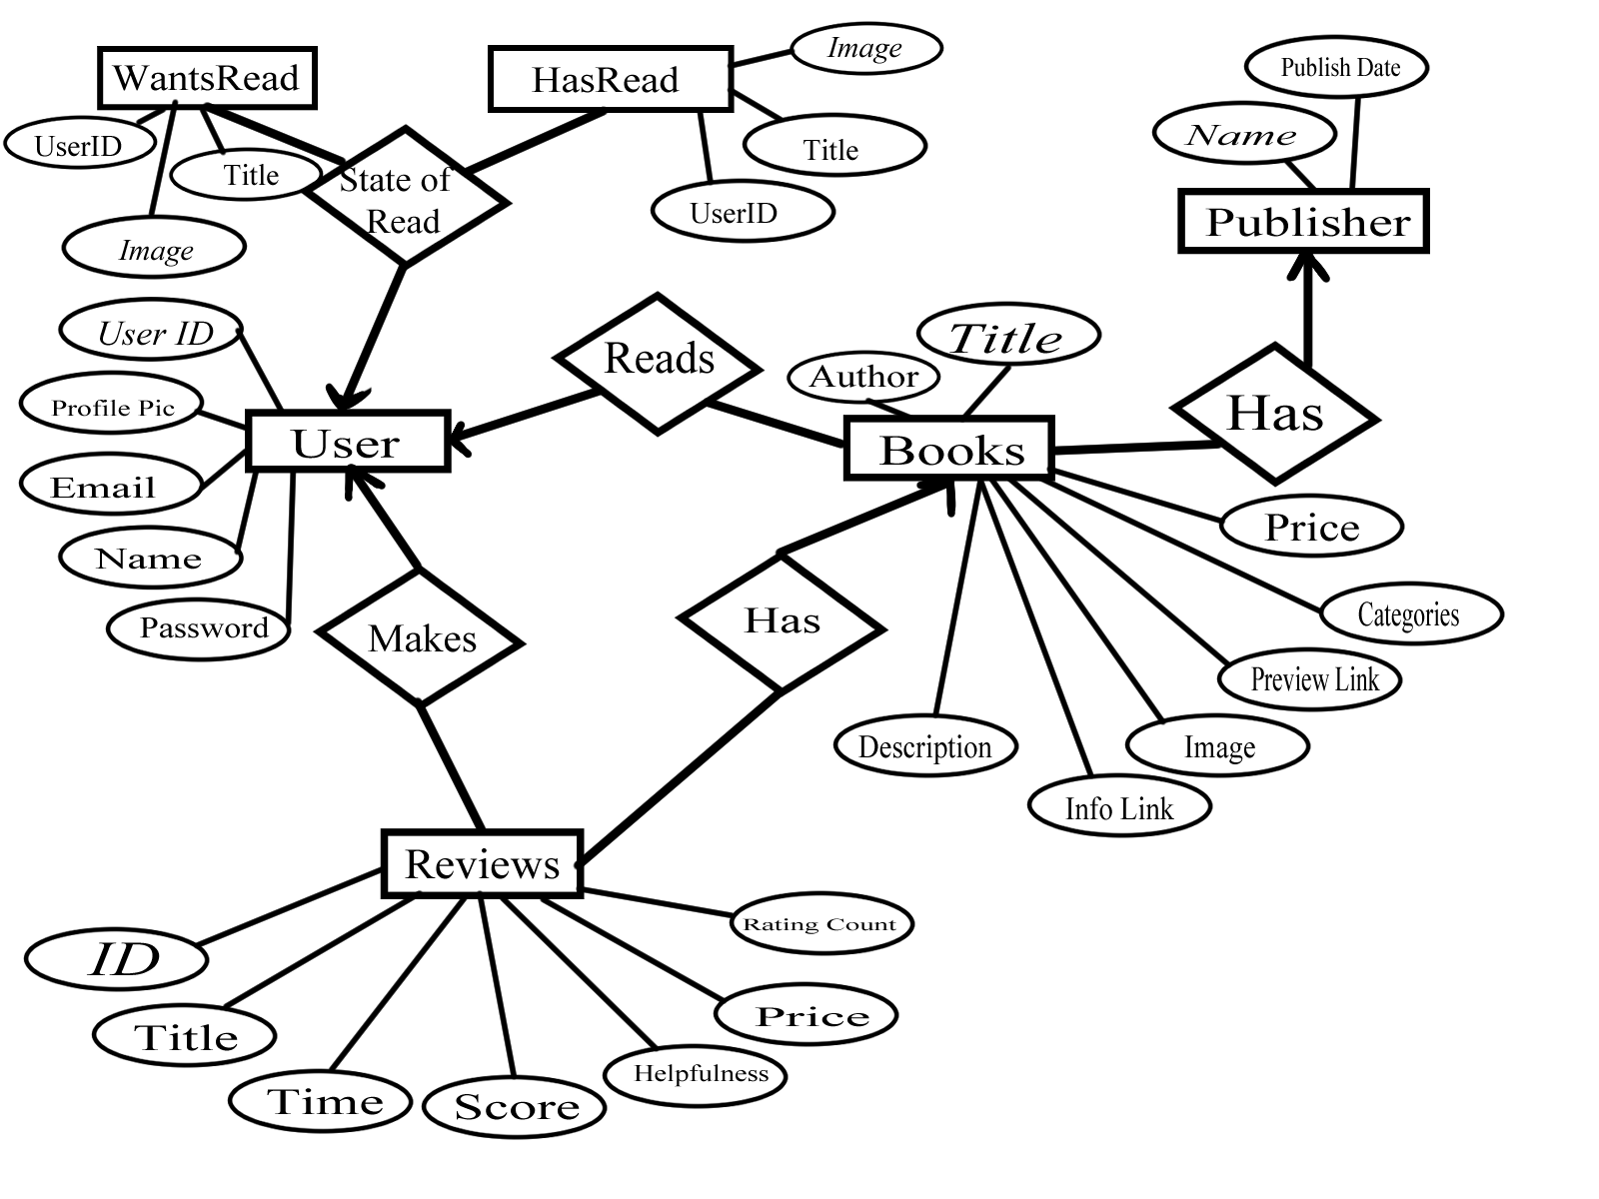
Our ER Diagram

Slide 6
Relation Models
User(UserID, Email, Password, ProfilePic, Name)
UserID is the primary key, Email and Password are also key
Book(Title, Genre, Image, Price, Description, InfoLink, PreviewLink, Author)
Title is the primary key
Publisher(Name, PublishDate)
Name is the primary key
Reviews(ID, Score, Price, RatingCount, Helpfulness, Title, Time)
ID is the primary key
WantsRead(Image, Title, UserID)
Image is primary key
HasRead(Image, Title, UserID)
Image is primary key

Slide 7
Backend and Frontend
We are using php files for backend, and HTML for the frontend. We use stored procedures and a php file called bookGrabber to call those files. bookGrabber.php is then called by the main page to retrieve information from the database.

Slide 8
Queries
DELIMITER $$
CREATE PROCEDURE GetBooksReadByUser (IN uid INT)
BEGIN
SELECT b.title, h.DateRead
FROM HasRead h
JOIN Books b ON h.bookID=b.BookID
WHERE h.UserID = uid;
END $$
DELIMITER;
CREATE PROCEDURE GetBookImage (IN bookTitle VARCHAR(255)) BEGIN SELECT Image
FROM Book
WHERE Title = bookTitle;
END $$ DELIMITER;
DELIMITER $$
CREATE PROCEDURE getReviewsOnDate(IN selTime BIGINT)
BEGIN
SELECT ID FROM Reviews
WHERE Time > selTime - 100000 AND Time < selTime + 100000;
END $$
DELIMITER;
DELIMITER $$
CREATE PROCEDURE publisherOfBook(IN pubName varchar (255)))
BEGIN
SELECT b.Title FROM Book b, Publisher p
WHERE p.name = pubName;
END $$
DELIMITER;

Slide 9
Queries Continued
DELIMITER $$ CREATE PROCEDURE getAllFriends()
BEGIN SELECT * FROM Friend
END $$
DELIMITER;
DELIMITER $$ CREATE PROCEDURE GetAllUsers()
BEGIN SELECT * FROM User
END $$
DELIMITER;
DELIMITER $$ CREATE PROCEDURE GetAllReviews()
BEGIN SELECT * FROM Reviews
END $$
DELIMITER;
DELIMITER $$ CREATE PROCEDURE GetAllBooks()
BEGIN SELECT * FROM Book
END $$
DELIMITER;
DELIMITER $$
CREATE PROCEDURE GetBooksByCategory (IN category VARCHAR(255))
BEGIN
SELECT Title
FROM Book
WHERE Categories = category;
END $$
DELIMITER;

Slide 10
Even More Queries
DELIMITER $$
CREATE PROCEDURE GetBooksByAuthor (IN Author VARCHAR(255))
BEGIN
SELECT Title
FROM Book
WHERE Author = author
END $$
DELIMITER;
DELIMITER $$
CREATE PROCEDURE GetAllUserEmails()
BEGIN SELECT Email
FROM User;
END $$
DELIMITER;
DELIMITER $$
CREATE PROCEDURE GetUserEmail(IN selUser Varchar(255))
BEGIN
SELECT Email
FROM User
WHERE Name = selUser;
END$$
DELIMITER;
DELIMITER $$
CREATE PROCEDURE ofUserRatingAbove(IN selUser Varchar(255))
BEGIN
SELECT r.Rating_Count FROM Reviews r, User u
WHERE u.Name = selUser AND r.Rating_Count>4;
END $$
DELIMITER;

Slide 11
MORE QUERIES
Shortened:
getBooksPaginated
orderOfBooksRead
getFriendsOf
addHours
subHours
addBooks
subBooks
addBookToReadList
addBooksToReadList
addBookToWillReadList
getBookImagesByCategory
getAllMutualFriendsOf
getBooksReadByUser
getReviewsAndBooks

Slide 12
Evaluation
We were able to access the database and edit it from the website. It took a lot of looking into frontend and backend interaction to just decide to use php for the backend. Kelsey was able to make a really nice website with php and we wanted to keep that. Ryan was able to adapt to php and got it to let the backend interact with the database. I, Jarod, have been helping everyone keep on task and helping where I can.
Overall, we did good, especially Kelsey and Ryan. We got the website to function as well as we could make it. Considering that all of us were out of our depths in connecting everything, we did pretty well.

Slide 13
Lessons Learned
The biggest lesson we learned is to research what we are going to do before doing it. We were very disorganized in getting everything to fit together. Once we had an end goal, a lot of the project came together. We ran into a few problems that caused us a bit of panic. However we got through them.

Slide 14
Conclusion
We had large ambitions for our project and wrote over 30 stored procedures for it, however we underestimated how many obstacles we’d encounter and as a result, we have a much worse project than any of us would like. It was however a good lesson. If we started earlier, surely we’d have a very polished and presentable final project.

